Slide 1



UNH SEDS
CEPS Engineering Organization
High Power Rocketry
University of New Hampshire
Students for the Exploration and Development of Space

Slide 2

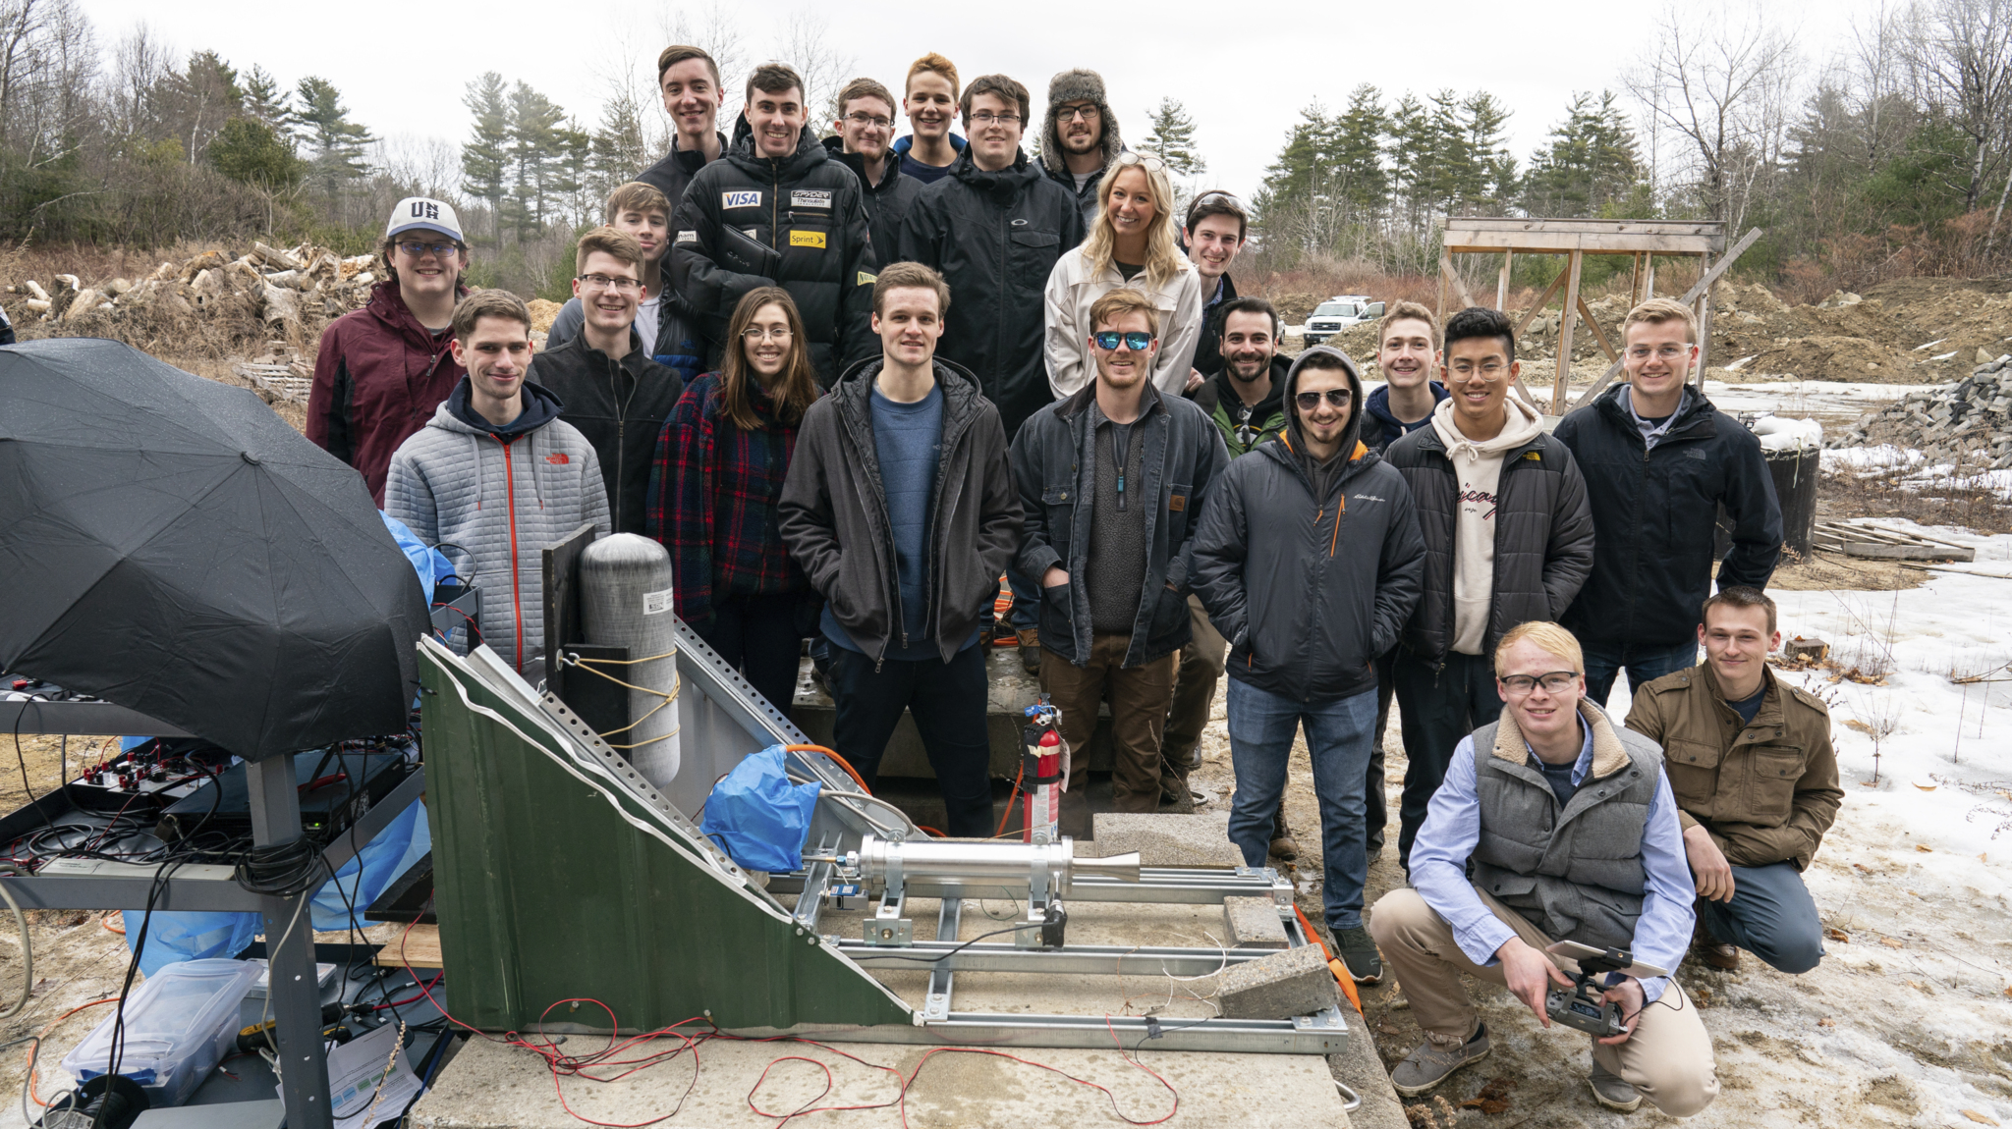
March 6th Hot Fire Test
University of New Hampshire
Students for the Exploration and Development of Space

Slide 3
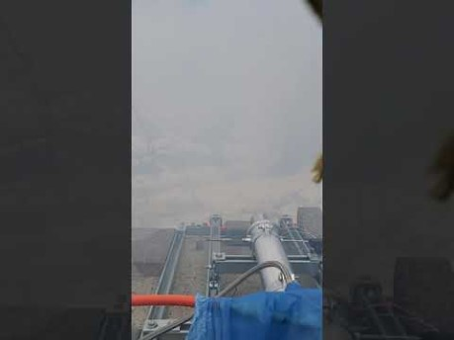
University of New Hampshire
Students for the Exploration and Development of Space
Notes:
Seds is a naitionwide organization that allows colleges from around the world to start a chapter. Although we are allowed to do whatever we would like as an organization, they do sponsor competition for SEDS groups as well as national conferences, the next one for the beginning of November. We are a team comprised of many majors and all classes, so applying to join our team would not only be a senior project, but an interdisciplinary experience.

Slide 4
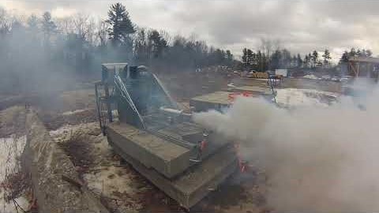
University of New Hampshire
Students for the Exploration and Development of Space

Slide 5
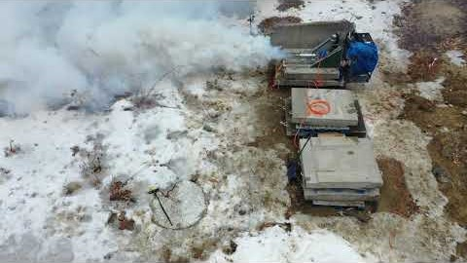
University of New Hampshire
Students for the Exploration and Development of Space

Slide 6
University of New Hampshire
Students for the Exploration and Development of Space

Slide 7
University of New Hampshire
Students for the Exploration and Development of Space

Slide 8
NOS Flow Rate: 0.064 kgs/sec
NOS Flow Rate: 0.14 lbs./sec
University of New Hampshire
Students for the Exploration and Development of Space

Slide 9
University of New Hampshire
Students for the Exploration and Development of Space

Slide 10
Engine Specs.
I_{sp}=45.29 sec
Specific impulse (usually abbreviated I_{sp}) is a measure of how effectively a rocket uses propellant or a jet engine uses fuel.
By definition, it is the total impulse (or change in momentum) delivered per unit of propellant consumed and is dimensionally equivalent to the generated thrust divided by the propellant mass flow rate or weight flow rate.
University of New Hampshire
Students for the Exploration and Development of Space

Slide 11
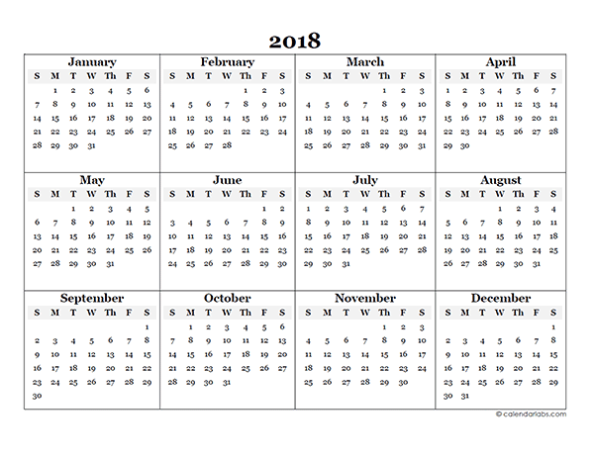
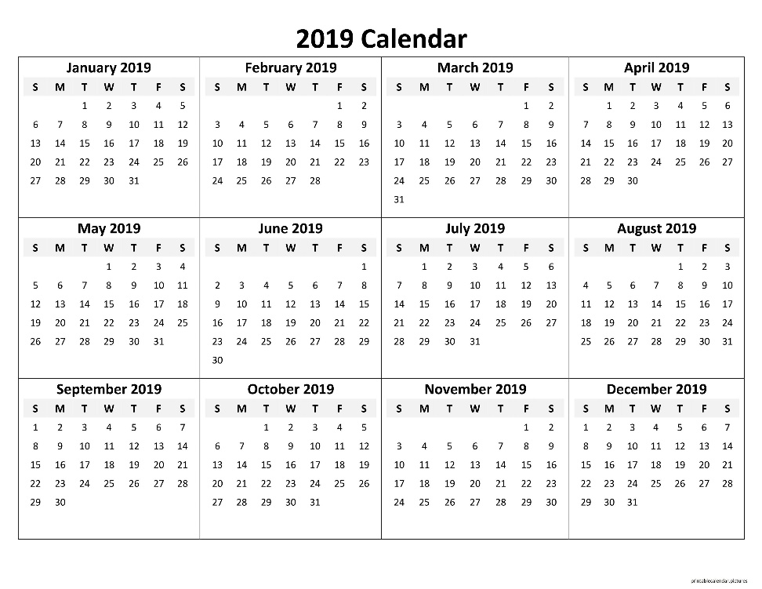
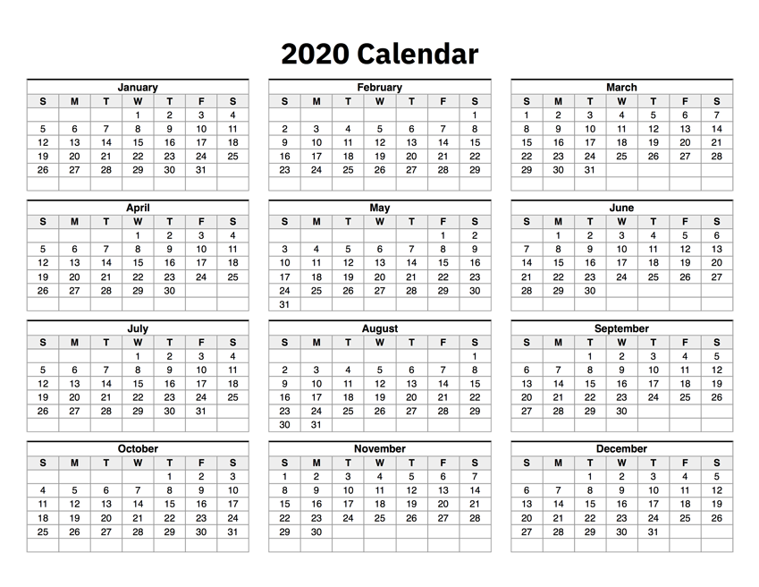

Hot Fire Schedule in Review
University of New Hampshire
Students for the Exploration and Development of Space

Slide 12
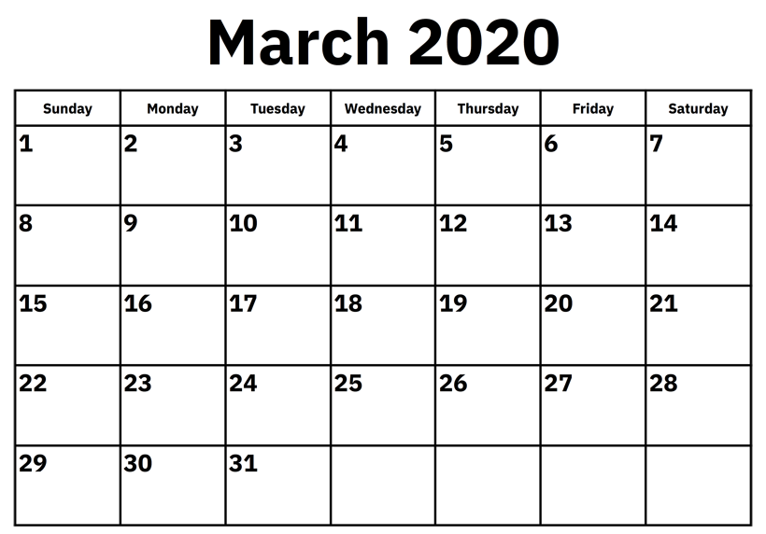


University of New Hampshire
Students for the Exploration and Development of Space

Slide 13

Finance Announcement
We need more funding in order to pay for rocket components, SpacePort travel costs, and the team banquet
Any company you have connections with
Reach out on Slack

